Slide 1
A Supermarket Management Database System Based on Entity-Relationship Model
代一飞 Yifei DAI 121090093
韩凯赢 Kaiying HAN 121090155
吕游 You LV 121090404
马腾飞 Tengfei MA 121090406
马铁丁 Tieding MA 121090407
毛斯玄 Sixuan MAO 121090414
谢子钰 Ziyu XIE 121090642

Slide 2
Contents
1
Database Design
2
Functional Design
3
Backend Implementation
4
Frontend Demonstration
4
5
GPT-powered Smart Database

Slide 3
Database Design
The ER Diagram, Relation Schemas, and Dependencies

Slide 4
Main Needs of Supermarkets
Including product management, product supply, product sales, and employee management.
01
Product Management System
02
Product Supply System
The Product Management System is responsible for product assortment, pricing and inventory control.
The Product Supply System manages the information of suppliers. They store supplier purchasing conditions, prices and delivery times.
03
Product Sales System
04
Employee Management System
The Product Sales System mainly records customer data, transaction data and some discount information.
The Employee Management System mainly stores employee information and is used to interact with other records.

Slide 5
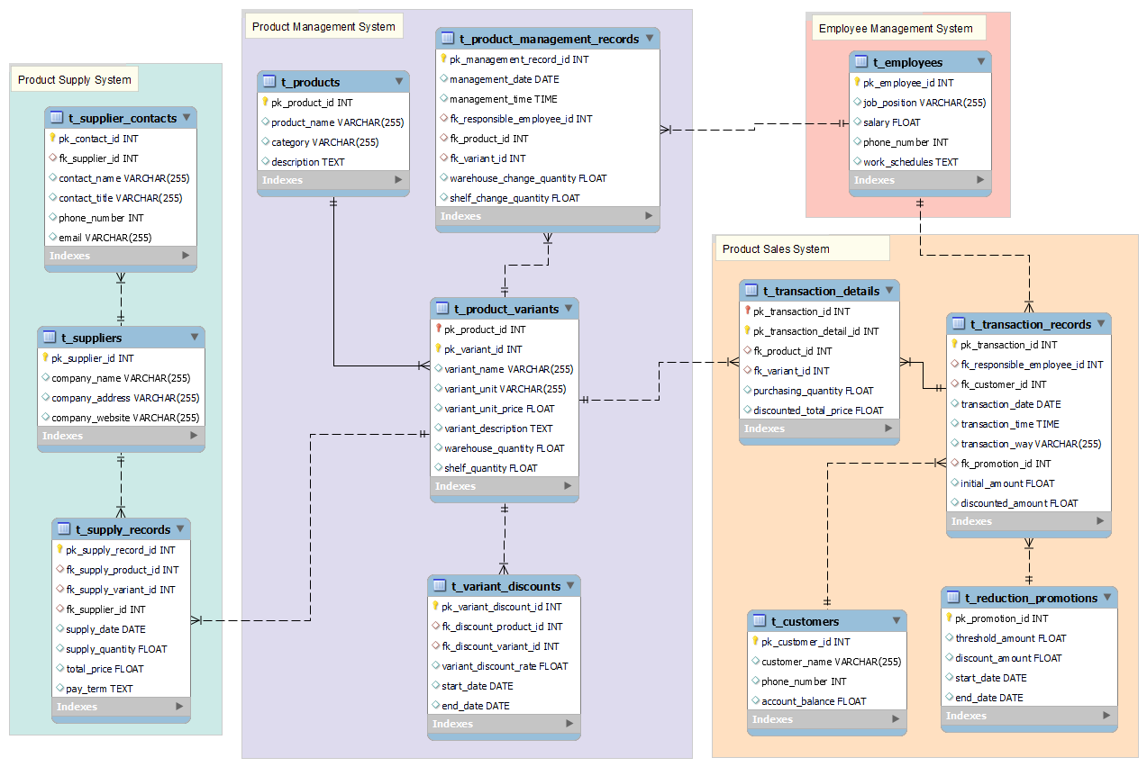
Entity-Relationship Diagram

Slide 6
Product Management System
t_products (
pk_product_id,
product_name,
category,
description)
t_product_variants (
pk_product_id,
pk_variant_id,
variant_name,
variant_unit,
variant_unit_price,
variant_description,
warehouse_quantity,
shelf_quantity)
t_product_management_records (
pk_management_record_id,
management_date,
management_time,
fk_responsible_employee_id,
fk_product_id,
fk_variant_id,
warehouse_change_quantity,
shelf_change_quantity)
t_variant_discounts (
pk_variant_discount_id,
fk_discount_product_id,
fk_discount_variant_id,
variant_discount_rate,
start_date,end_date)
→ t_employees
→ t_product_variants
→ t_products
→ t_product_variants

Slide 7
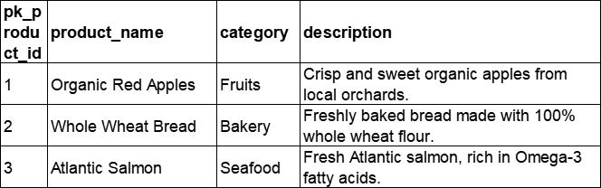
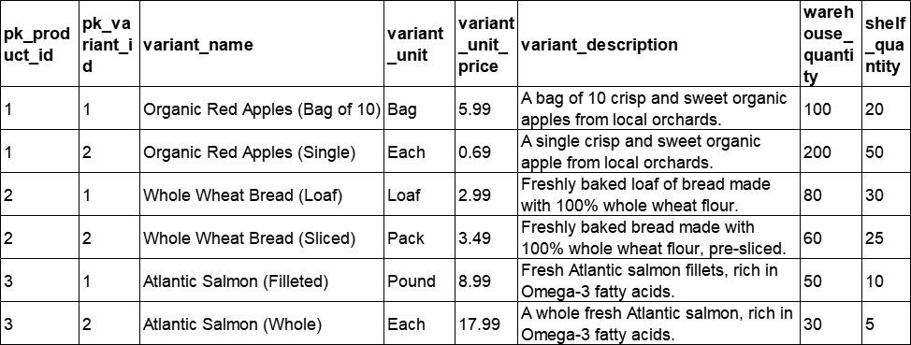
Product Management System
t_products (
pk_product_id,
product_name,
category,
description)
t_product_variants (
pk_product_id,
pk_variant_id,
variant_name,
variant_unit,
variant_unit_price,
variant_description,
warehouse_quantity,
shelf_quantity)
→ t_products

Slide 8
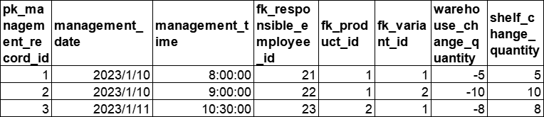
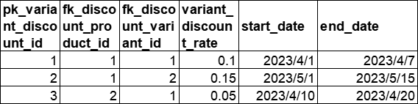
Product Management System
t_product_management_records (
pk_management_record_id,
management_date,
management_time,
fk_responsible_employee_id,
fk_product_id,
fk_variant_id,
warehouse_change_quantity,
shelf_change_quantity)
t_variant_discounts (
pk_variant_discount_id,
fk_discount_product_id,
fk_discount_variant_id,
variant_discount_rate,
start_date,end_date)
→ t_employees
→ t_product_variants
→ t_product_variants

Slide 9
Product Supply System
t_suppliers (
pk_supplier_id,
company_name,
company_address,
company_website)
t_supplier_contacts (
pk_contact_id,
fk_supplier_id,
contact_name,
contact_title,
phone_number,
email)
t_supply_records (
pk_supply_record_id,
fk_supply_product_id,
fk_supply_variant_id,
fk_supplier_id,
supply_date,
supply_quantity,
total_price,
pay_term)
→ t_product_variants
→ t_supplier
→ t_supplier

Slide 10
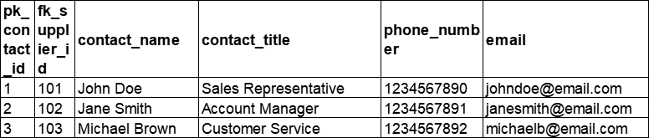
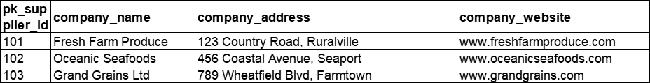
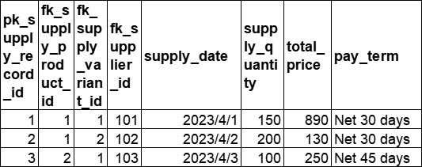
Product Supply System
t_suppliers (
pk_supplier_id,
company_name,
company_address,
company_website)
t_supplier_contacts (
pk_contact_id,
fk_supplier_id,
contact_name,
contact_title,
phone_number,
email)
→ t_supplier
t_supply_records (
pk_supply_record_id,
fk_supply_product_id,
fk_supply_variant_id,
fk_supplier_id,
supply_date,
supply_quantity,
total_price,
pay_term)
→ t_product_variants
→ t_supplier

Slide 11
Product Sales System
t_transaction_records (
pk_transaction_id,
fk_responsible_employee_id,
fk_customer_id,
transaction_date,
transaction_time,
transaction_way,
fk_promotion_id,
initial_amount,
discounted_amount)
t_customers (
pk_customer_id,
customer_name,
phone_number,
account_balance)
t_transaction_details (
pk_transaction_id,
pk_transaction_detail_id,
fk_product_id,
fk_variant_id,
purchasing_quantity,
discounted_total_price)
t_reduction_promotions (
pk_promotion_id,
threshold_amount,
discount_amount,
start_date,
end_date)
→ t_transaction_records
→ t_employees
→ t_customers
→ t_product_variants
→ t_reduction_promotions

Slide 12
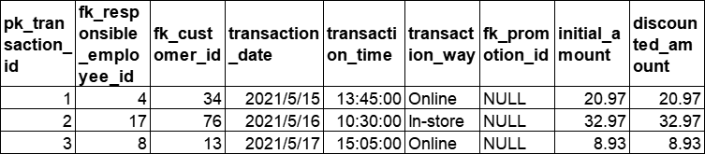
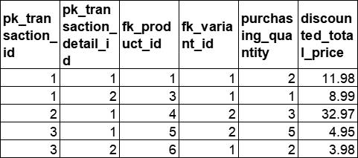
Product Sales System
t_transaction_records (
pk_transaction_id,
fk_responsible_employee_id,
fk_customer_id,
transaction_date,
transaction_time,
transaction_way,
fk_promotion_id,
initial_amount,
discounted_amount)
→ t_employees
→ t_customers
→ t_reduction_promotions
t_transaction_details (
pk_transaction_id,
pk_transaction_detail_id,
fk_product_id,
fk_variant_id,
purchasing_quantity,
discounted_total_price)
→ t_transaction_records
→ t_product_variants

Slide 13
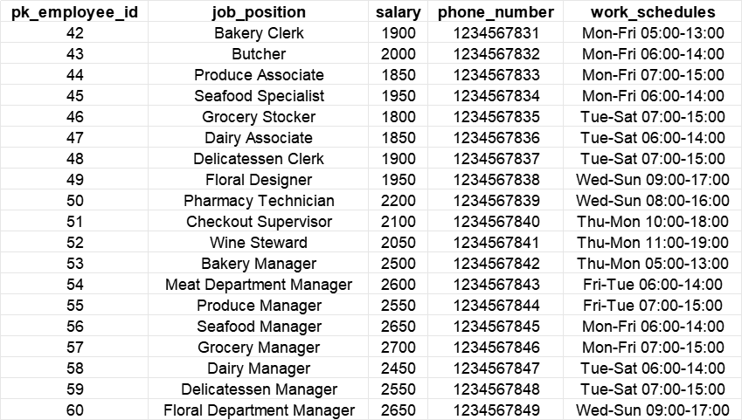
Employee Management System
t_employees (
pk_employee_id,
job_position,
salary,
phone_number,
work_schedules)

Slide 14
Analysis of the Database Design
About the functional and/or multivalued dependencies
All the tables have only one primary key (single attribute or in composition form) and no other candidate keys. The functional dependencies in the form X → Y, where:
X must be the primary key of R, Y can only be nonprime attributes
Therefore, any table neither has a transitive dependency, nor partial dependency.
In conclusion, all the tables are at least in Third Normal Form (3NF).
For example, the table t_transaction_details (primary key in composition form) is shown below. All the other tables are similar to the form of this table, hence omitted here.
pk_transaction_id | pk_transaction_details_id | fk_product_id | fk_variant_id | purchasing_quantity | discounted_total_price

Slide 15
Functional Design

Slide 16
Functional Design Overview
Including product management, product supply, product sales, and employee management.
01
Product Management System
02
Product Supply System
1. Take a list of goods
2. Shelf renewal decision
3. Product addition
4. Production delete
1. Distribution of suppliers
2. Supplier selection decision support
3. Warehouse renewal decision
4. Goods order
5. New supplier
03
Product Sales System
04
Employee Management System
1.Sales volume analysis of different goods
2. New purchase record
1. Sales worker management
2. Warehouse worker management
3. Employee salary management
4. Employee change
5. Query personal information

Slide 17
Design Motivation
Data-driven Decision Making
Aggregate and analyze data to support more accurate business decisions.
Efficiency Improvement
Centralized Management
Flow routine tasks, reduce manual errors, improve work efficiency.
Simplify operational processes and improve data accessibility and consistency.

Slide 18
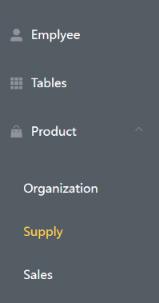
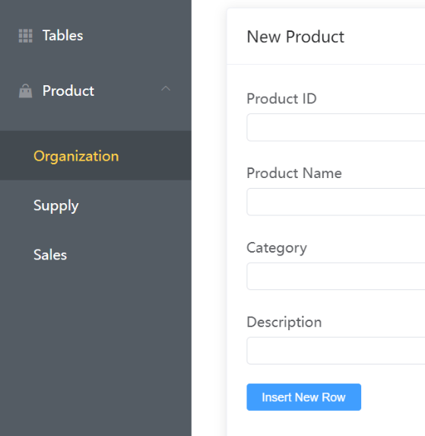
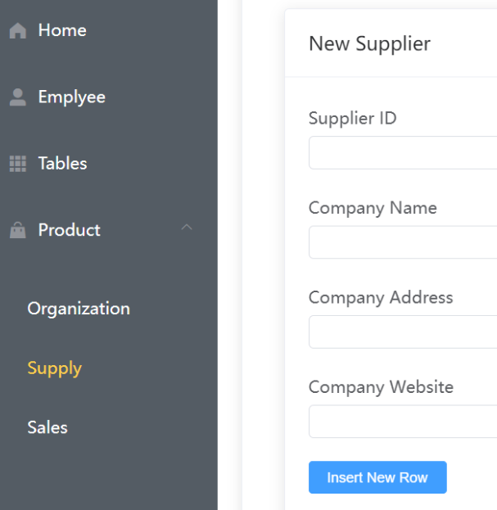
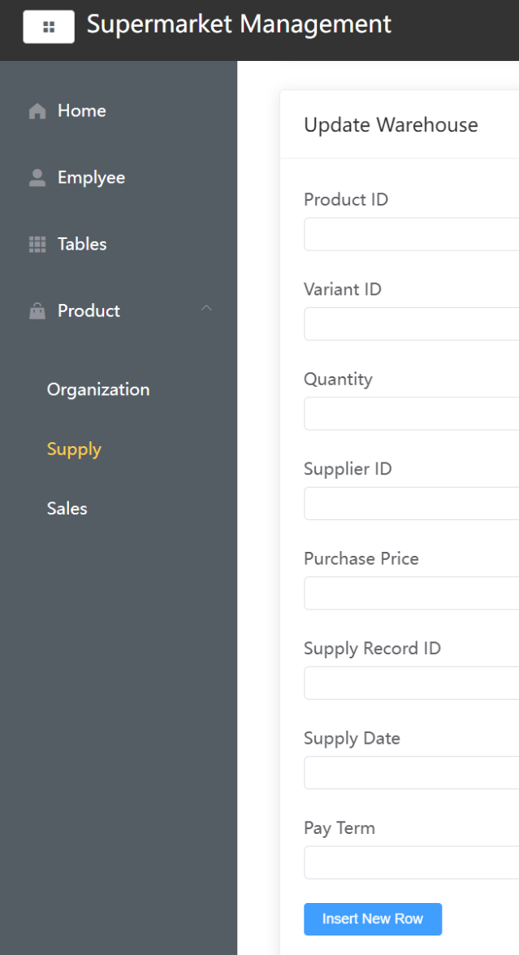

Specific Function Implementation
Past
Now
Centralized Management
By integrating and streamlining the supply-chain-management-sales-inventory system, this approach simplifies the operational processes and reduces the complexity for business personnel, thereby enhancing the accessibility and consistency of data."Four Independent Systems"
Four Independent Systems
Employee Organization Supply Sales
Product addition
*Optional
Improve Efficiency
By standardizing routine tasks, this approach reduces human errors and simultaneously increases work
efficiency.

Slide 19
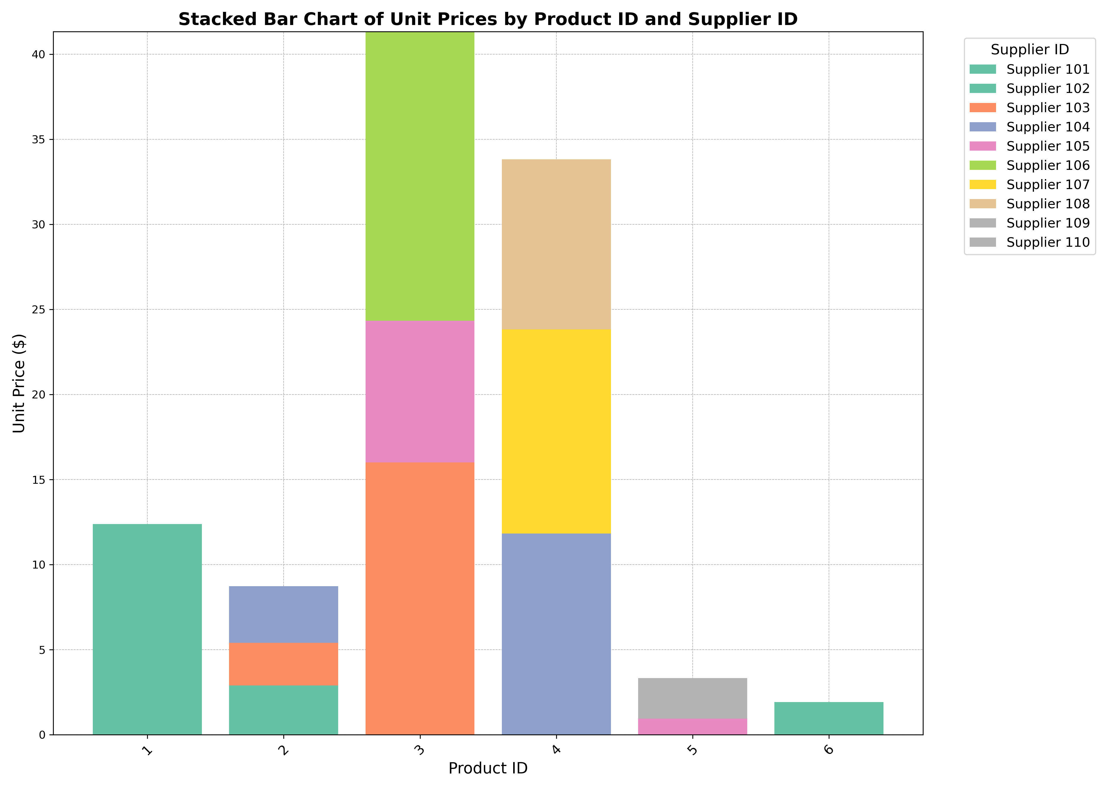
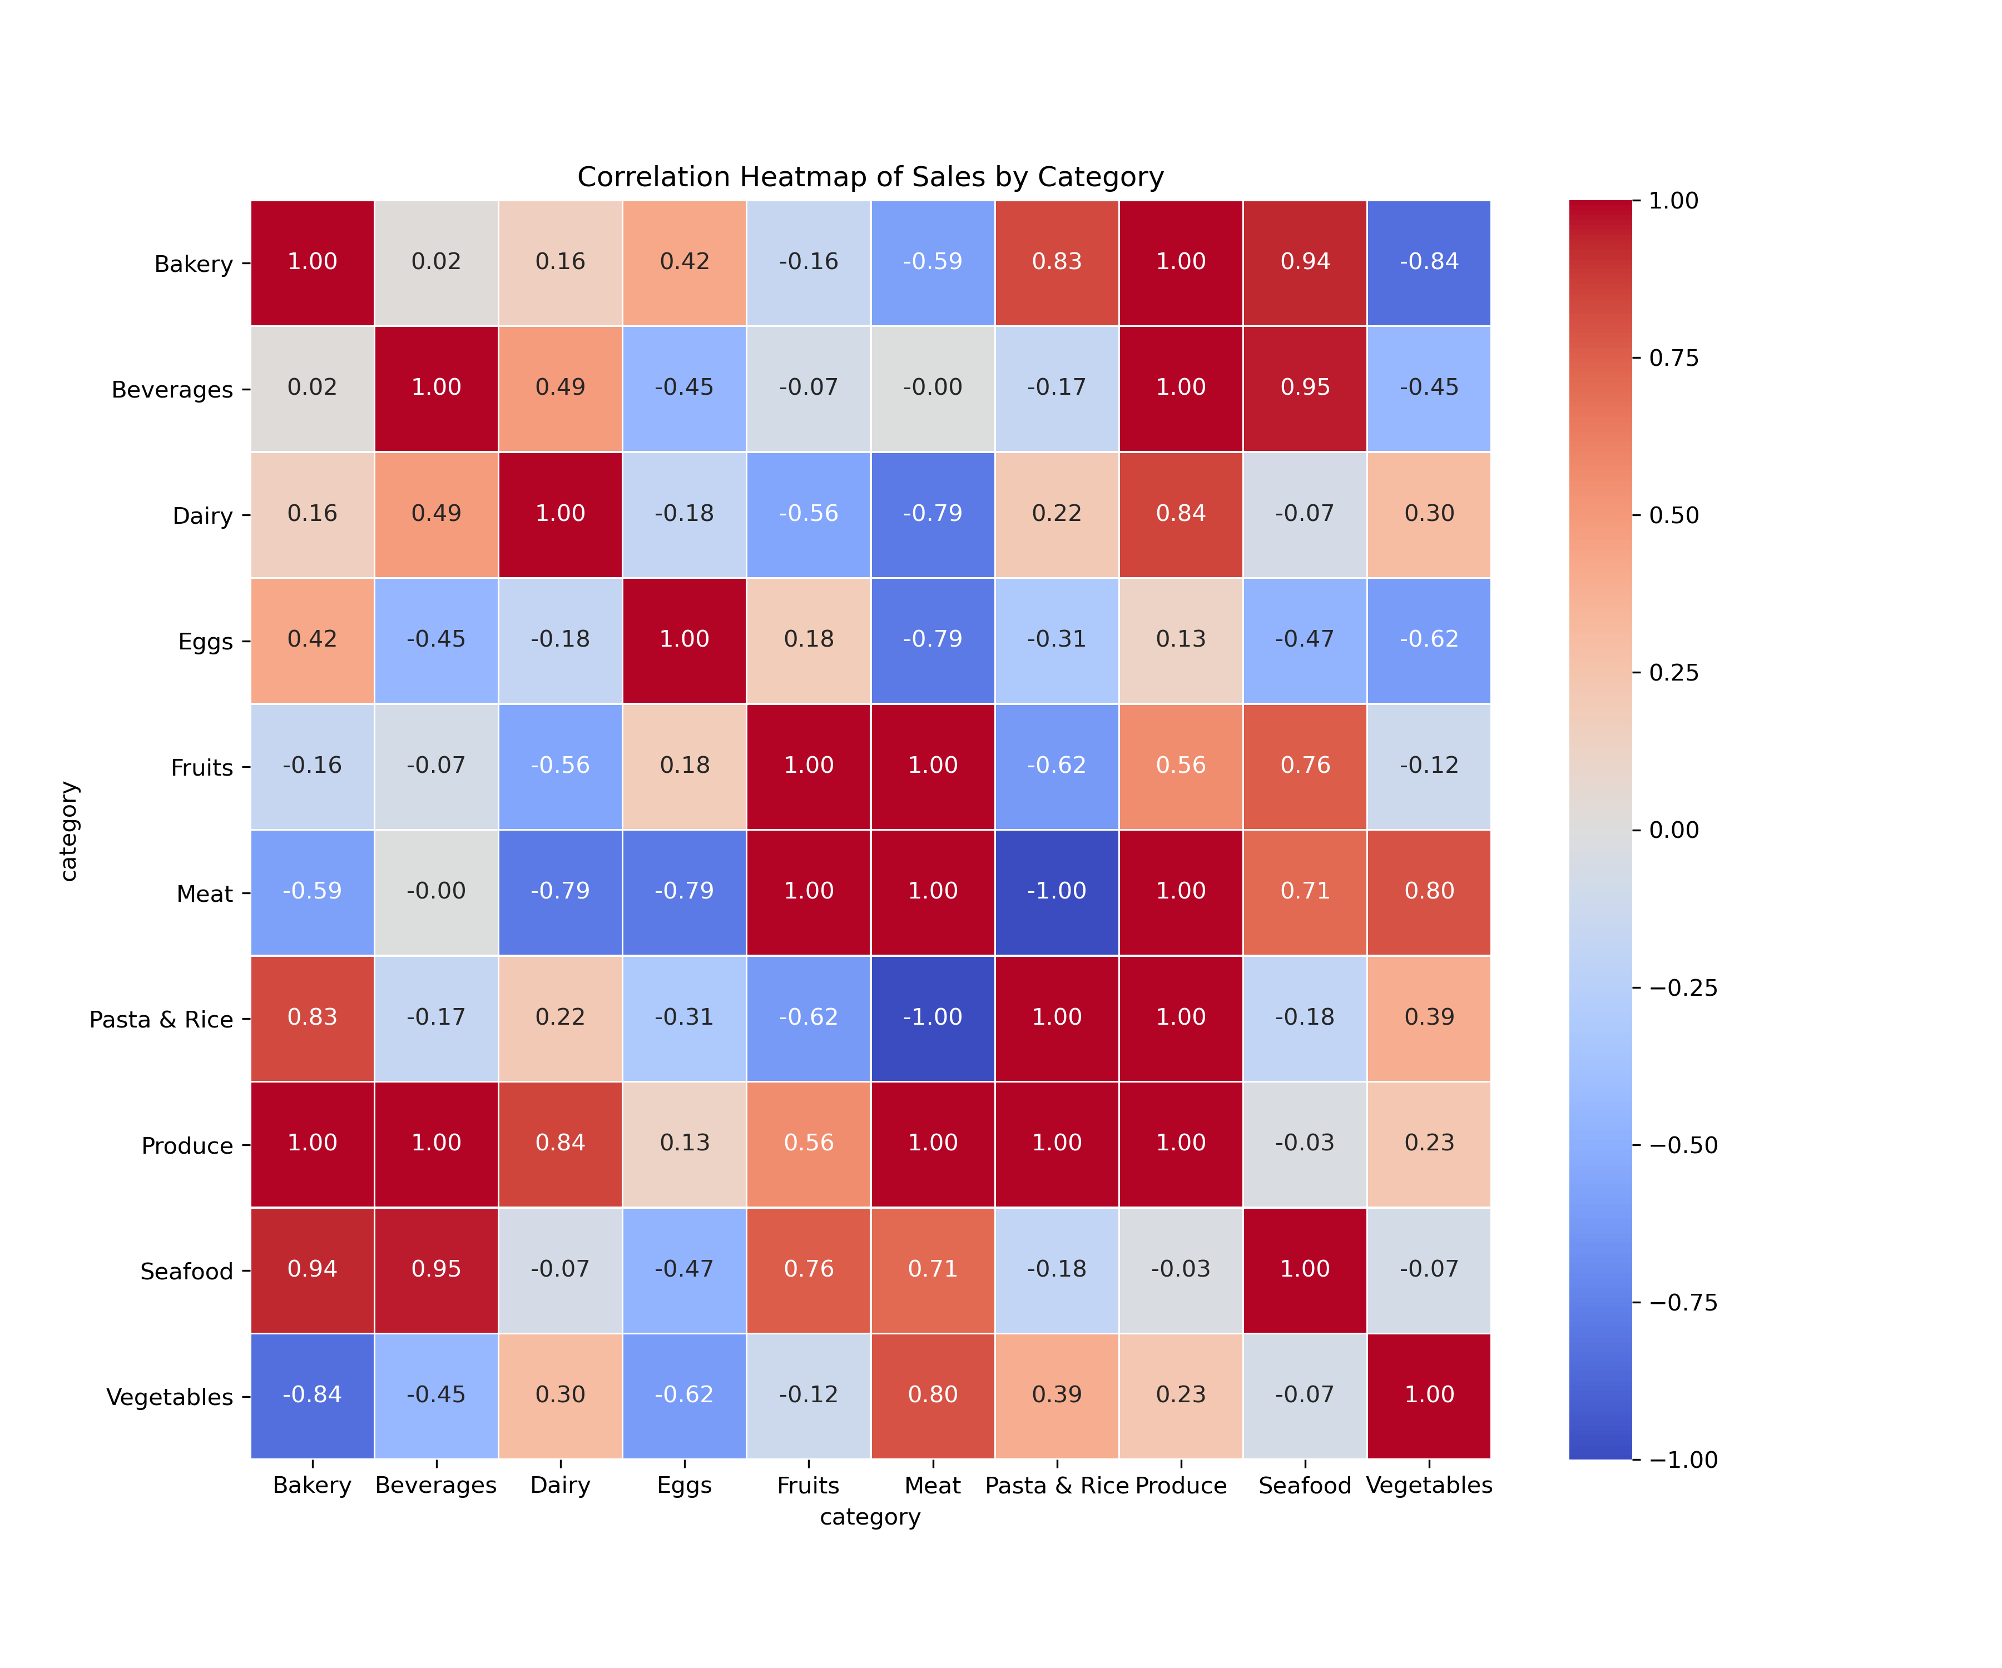
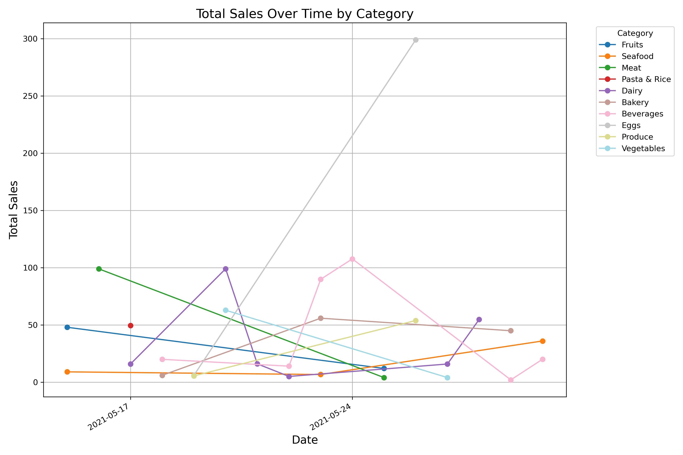
Specific Function Implementation
Data-driven Decision making
Supplier selection
decision support
Sales volume analysis of
different goods
Compare the supply prices from different suppliers for the same product ID to select the cheapest supplier.
Draw a trend chart of sales volumes over time for different products.
Create a heatmap of sales correlations between different products for better analysis.

Slide 20
Backend Implementation
Use javascript to connect MySQL to Vue

Slide 21
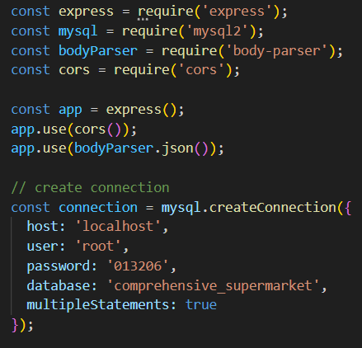
Connect to MySQL Server
Dependencies
Configurations
the address of server
user name
Connection
password
database name
Allow multiple SQL statements at once

Slide 22
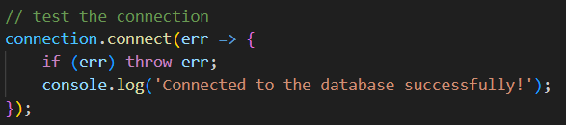
Test Connection
If successful connection, there will be a log printed on the screen.

Slide 23
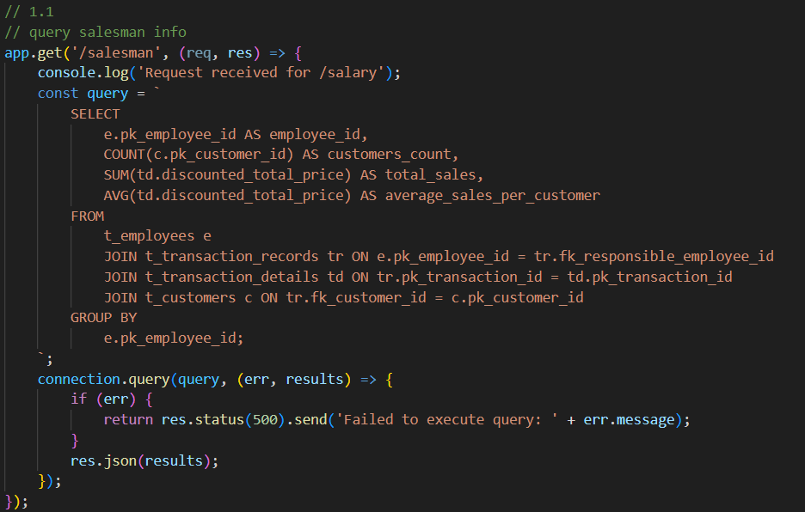
Execute SQL statements
Take one SQL statement for example.
Predefined SQL
Something Wrong
Return Query Result

Slide 24
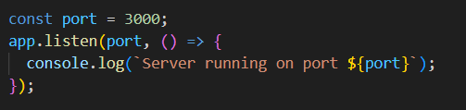
Start Server and Listen
Start the server and listen on port 3000
Log a message when the server is successfully running.

Slide 25
Frontend Demonstration

Slide 26
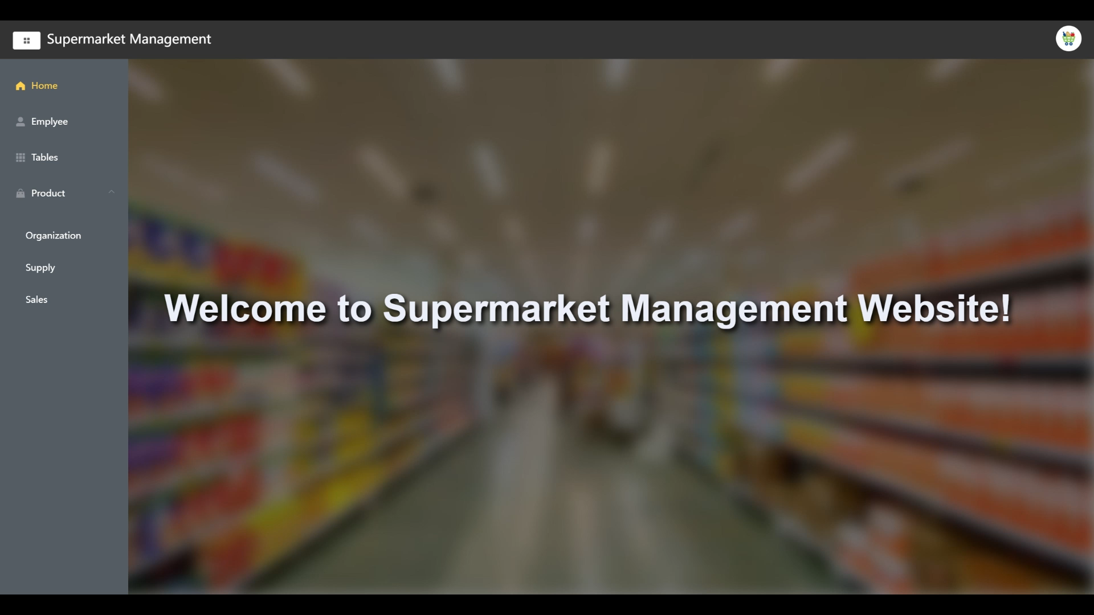
Live Demonstration

Slide 27
GPT-powered Smart Database

Slide 28
Features
01
Seamless Data Integration
02
Real-Time Interactive Responses
Local and Remote Data Accessibility: Connects seamlessly to MySQL database servers and directly reads data files, including those not yet updated to the database. This enables comprehensive access to diverse data sources for efficient querying.
Efficient Embedding and Query Generation: Utilizes RAG and Vector Store skills to generate embeddings for data and convert natural language queries into SQL prompts swiftly. Instant API Response: GPT API provides real-time responses, ensuring a smooth and natural Q&A experience for users. This real-time interaction enhances usability and productivity.
03
User-Friendly Interface
04
Enhanced Security and Reliability
Elimination of Technical Barriers: Eliminates the need for users to possess SQL or database expertise. With intuitive natural language processing capabilities, users can effortlessly retrieve data without intricate technical knowledge.
Streamlined Experience: Facilitates fast, smooth, and straightforward database interactions, reducing the learning curve and empowering users to efficiently navigate and extract insights from data.
Data Integrity Protection: Safeguards databases and data files from inadvertent modifications by restricting user permissions. Users are limited to searching for data, ensuring the integrity and consistency of the underlying data sources.
Robustness: Ensures robust performance and stability, enhancing confidence in the system's reliability and security. This emphasis on safety and resilience reinforces trust in the platform for critical data operations. can simply impress your audience and add a unique zing and appeal to your Presentations. Easy to change colors, photos and Text.

Slide 29
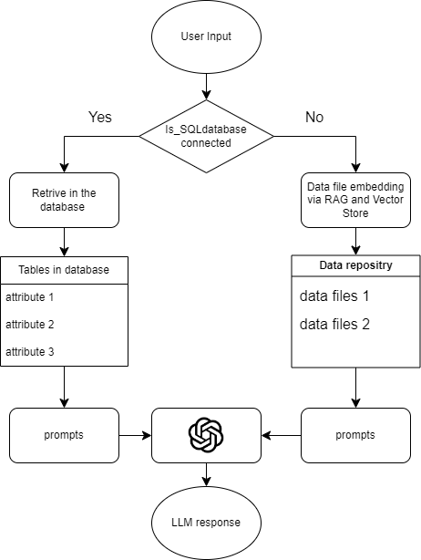
Process
Our smart database processes natural language queries by determining the source—SQL database or text files. For databases, it retrieves data directly; for text files, it uses RAG (Retrieval Augmented Generation) and Vector Store for embeddings. Generated prompts lead to a Language Model, which delivers real-time, accurate responses to the user.

Slide 30
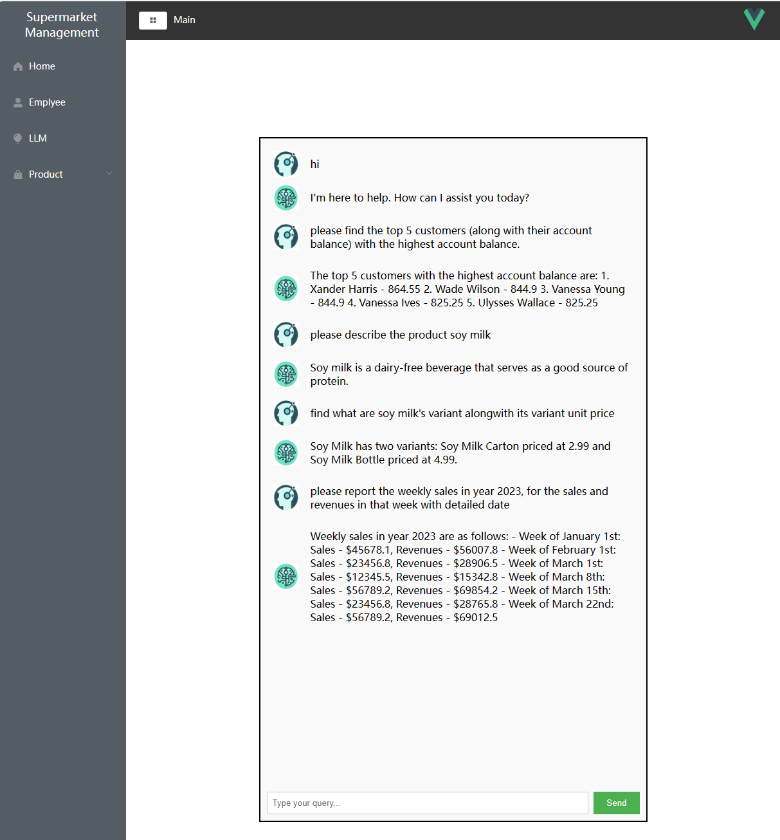
DEMO
The demo showcases our smart database’s capability to efficiently handle queries within a supermarket management system, ranging from identifying top customers by account balance, to describing products, listing variants and pricing, and reporting detailed weekly sales and revenues for the year 2023.

Slide 31
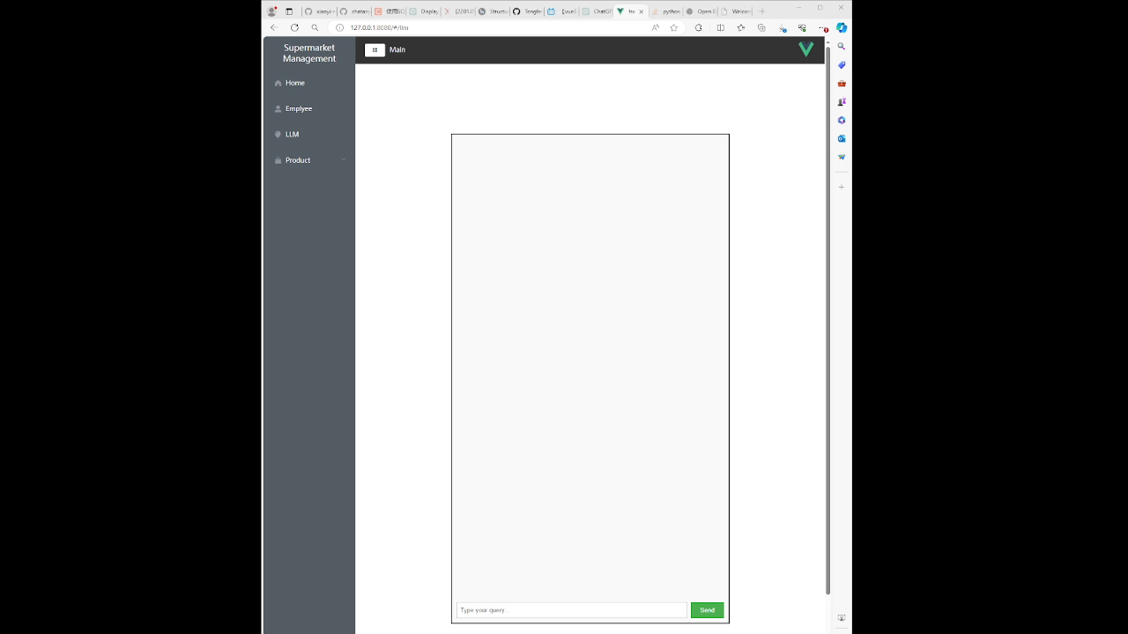
DEMO

